Slide 1
Classification for D2D Resource Allocation using Machine Learning and Deep Learning
Experiment 1
K Venkat Ramnan, Student Intern
Under Guidance of NB Mehta sir and Bala sir

Slide 2
Problem Statement Explained
Problem Statement : The subchannel allocation in D2D communication.
Maximize D2D sum rate
Ensuring min rate QOS for cellular Units/Users
Usage on only one subchannel
Number of D2D pairs
Fundamental Solution : Disjunctively Constrained Knapsack Problem (or) KP with conflicts
Challenge : Exponential Time Complexity
Proposed Solution : Machine learning / Deep Learning

Slide 3
Dataset Explained
Features :
Rates (V 1 ….. V 30) : 30 values
Weights (w 1 ….. w 30 ) : 30 Values
C : 1 Value
Target : X 1 …. X 30 : 30 Values
Here total number of instances(rows) for the above features and targets are 9210 values.
All the features and target are put together in a single CSV file. The total number of features accounts to 61 and target to 30 values.
Thus,
If X matrix denotes the features, the shape of matrix is (9210 x 61)
If Y matrix denotes the target, the shape of matrix is (9210 x 30)

Slide 4
Data preprocessing
No data is removed since all the data is mathematically important.
The data is split into two parts:
80 % as training data
20% as validation/testing data
Note: Here we are trying to predict X n one by one other. We are not predicting all 30 values at once.
Reason : Since Binary classification does not work on a 9210 x 30 matrix. It works well on a 9210 x 1 matrix.

Slide 5
Machine Learning Techniques
Logistic Regression
Supervised Learning Classification Algorithm
Linear in nature : Depends on sigmoid function
y = e^(b0 + b1*x) / (1 + e^(b0 + b1*x))
Logistic regression is a linear method, but the predictions are transformed using the logistic function.
P(X) = P(Y=1|X) ⇒ p(X) = e^(b0 + b1*X) / (1 + e^(b0 + b1*X))
Norm for penalization : L1 regularization : L1 penalty equal to the absolute value of the magnitude of coefficients. Thus it limits the size of coefficients

Slide 6
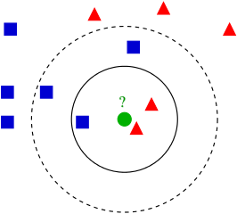
Machine Learning Techniques
2. K Nearest Classification
Simple Supervised Method for both classification and regression
Similar things exist in close proximity
Similarity : Distance (Euclidean, Hamming or Manhattan distance)
Non Parametric : no assumptions about probability distribution
Lazy learning : generalizes data in testing phase
Parameters in our case : (algorithm='auto', leaf_size=30, metric='minkowski',
metric_params=None, n_jobs=None, n_neighbors=30, p=2,
weights='uniform')

Slide 7
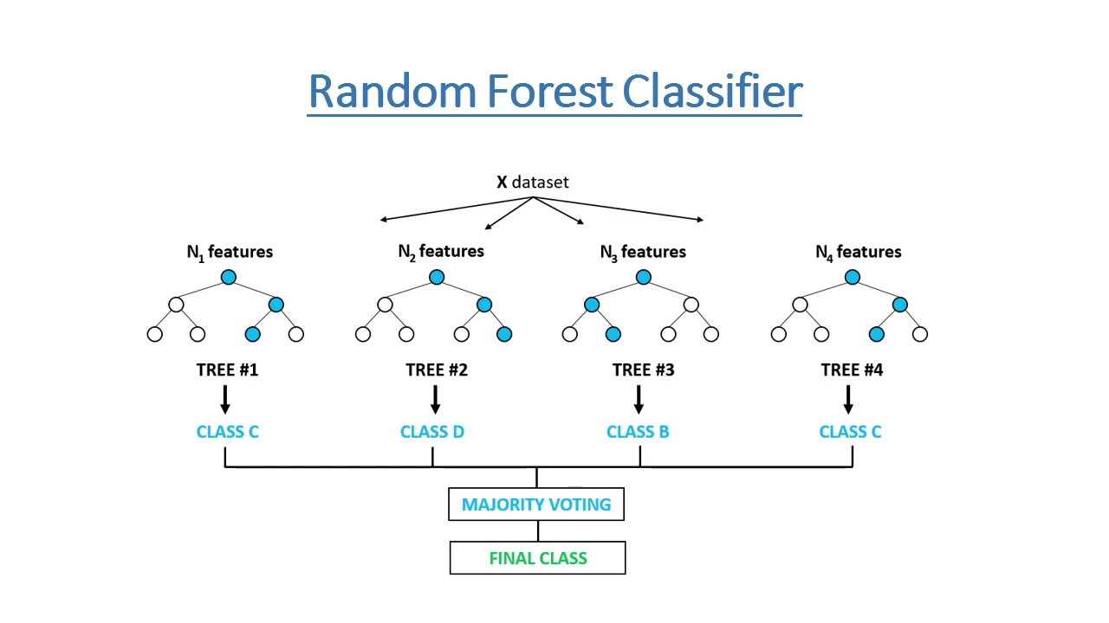
Machine Learning Techniques
3. Random Forest Classifier
Decision Tree : Building blocks of Random Forest
Large number of Decision trees working as an ensemble
Key : Low correlation between models : Uncorrelated outcomes
Trees protect each other from individual errors
Works with non linear data
aggregates the votes from different decision trees to decide
Here we take max depth of 30.

Slide 8
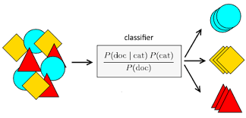
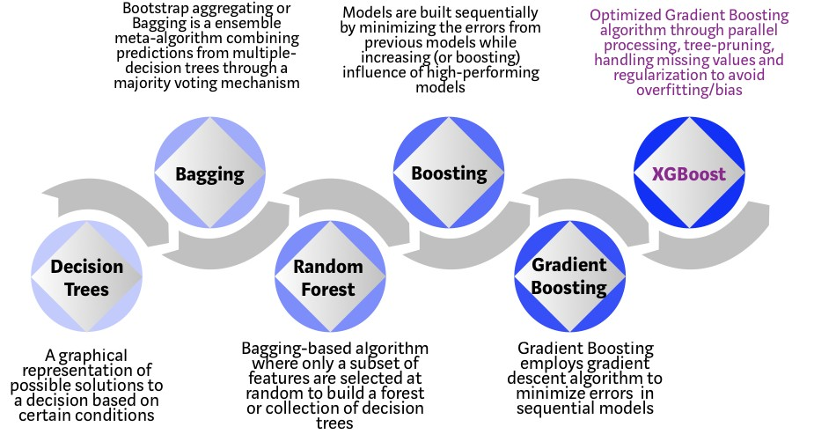
Machine learning techniques
4. Gaussian Naive Bayes Classifier
Based on bayesian probability (or) Bayes’ theorem
assumes that each input variable is independent
5. XGBoost Classification
Gradient Boosting Implementation
Boosting trees : Iterative
Rather than training all of the models in
isolation of one another ⇒ boosting trains
models in succession ⇒ with each new model
being trained to correct the errors made by the previous ones.

Slide 9
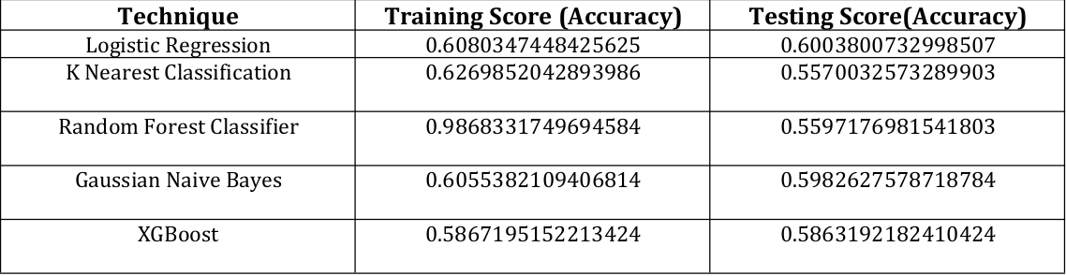
Results of ML techniques
Results : 55 to 60 percent accuracy
Note: All ML models built with Scikit Learn Library and Python.

Slide 10
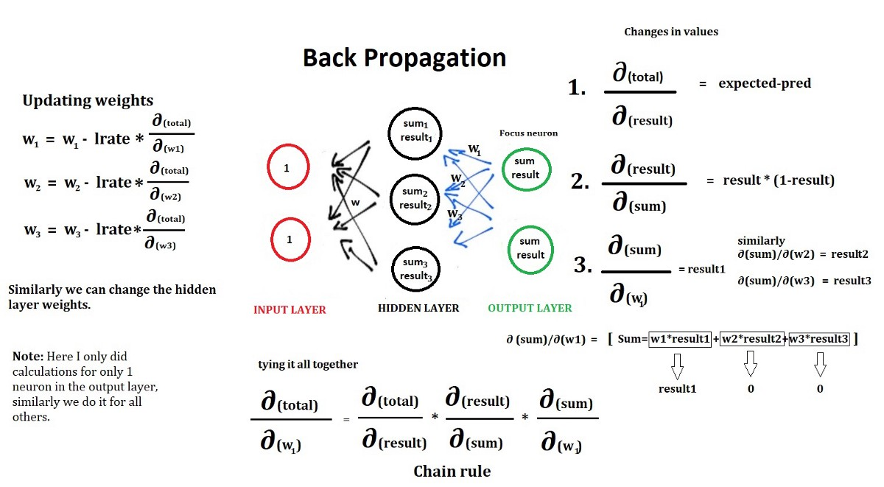
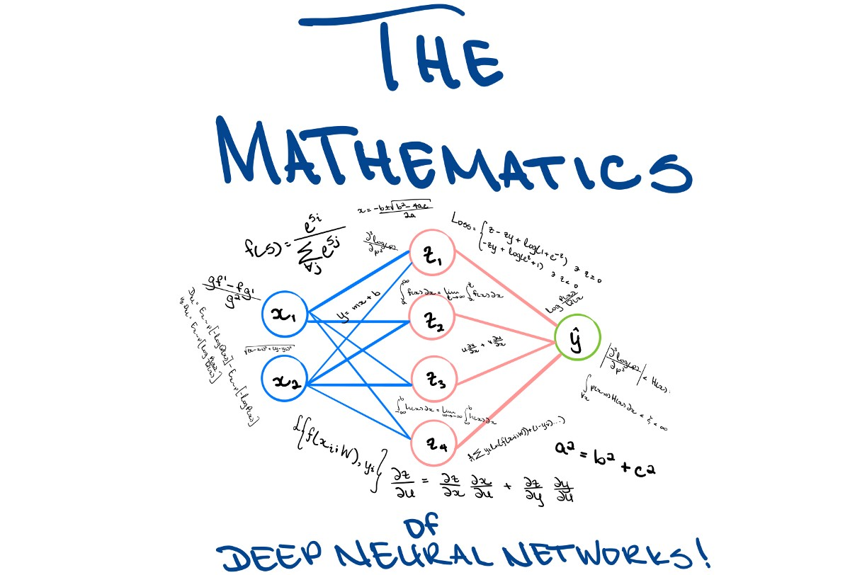
Deep Neural Network Classification

Slide 11
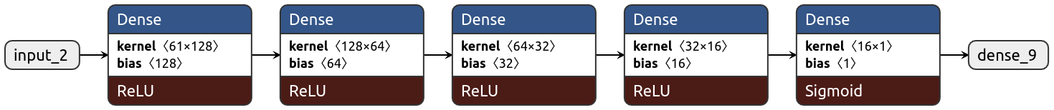
Model 1
Model 2
The Dropout layer randomly sets input units to 0 with a frequency of rate at each step during training time, which helps prevent overfitting. Inputs not set to 0 are scaled up by 1/(1 - rate) such that the sum over all inputs is unchanged.

Slide 12
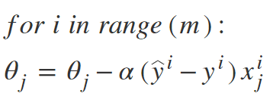
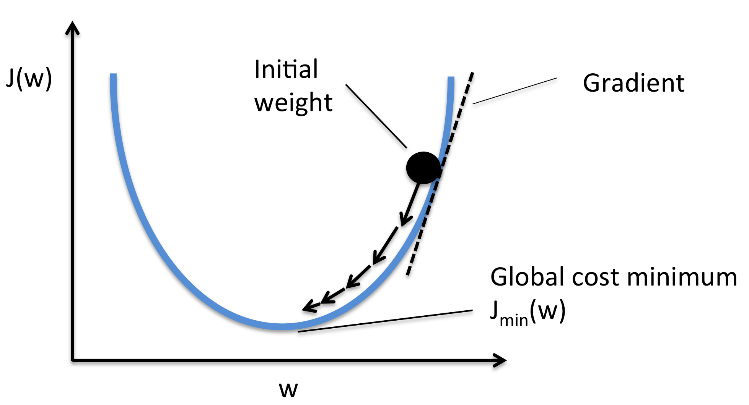

Model Training parameters
Optimizer Used : SGD
Learning Rate : 0.0001
Loss : Binary Cross entropy
Result Metric : Accuracy
Epochs Trained : 1000
Batch Size : 31

Slide 13
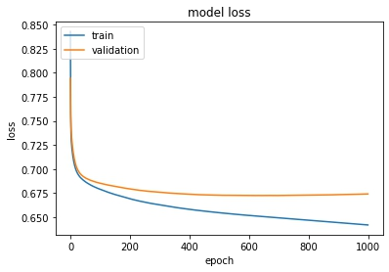
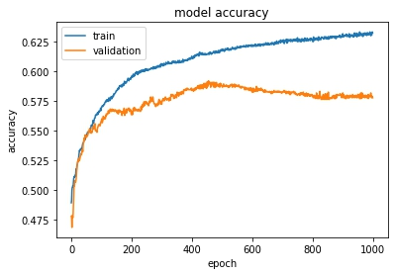
Results of Deep Learning models
Model 1
All models built with Keras(Tensorflow) and Google Colab with Python

Slide 14
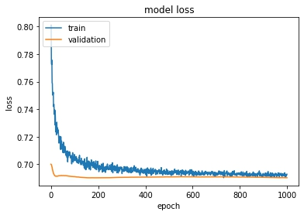
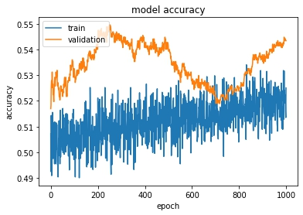
Results of Deep Learning Models
Model 2
All models built with Keras(Tensorflow) and Google Colab with Python

Slide 15
Conclusion
The DNN models also gave a validation accuracy of 55 to 60 percent. This is also similar to the previous Machine Learning models.
The split up of 0s and 1s are also perfect, i.e 50% 1s and 50% 0s. So there is nothing wrong with the split up of data and uniformity is maintained. But size of dataset is less. Since the number of features are high but instances are less.
The next steps :
1. Increase in Dataset
2. Building more robust model
3. Since the inclusion of disjunctivity is available as an adjacency matrix, techniques like Graph Neural Network can be explored.

